Slide 1
GENERAL
LABORATORY SAFETY!
OL I V I A W H I T E N E R , MI R E YA VA L E N C I A , KE L L I
KO K A M E

Slide 2

IN THE CASE OF AN EARTHQUAKE
If indoors….
Move away from objects that may fall (windows, filing cabinets, shelves, chemicals, etc.)
DUCK, COVER, and HOLD until shaking stops
Stay under cover until shaking stops
When shaking stops, go to nearest evacuation site
DO NOT USE ELEVATORS
If outdoors….
Move away from buildings, trees, signs, electrical poles, wires
When shaking stops, go to nearest evacuation site
BE PREPARED FOR AFTERSHOCKS

Slide 3

IN THE CASE OF A MEDICAL EMERGENCY
Do not move victim unless his/her location poses possible danger
IMMEDIATELY call 911 and Campus Safety @ (909)607-2000
Provide necessary first aid until Campus Safety / emergency services arrive

Slide 4
IN THE CASE OF CRIME ON CAMPUS
Report all crimes or suspicious activity to Campus Safety @ (909)607-2000
If there is a campus lockdown…
Go to the nearest room
Close and lock the door
If there is no lock, barricade the door
Cover door window, pull shades, turn off the light
Silence phones and stay quiet
Call 911 and then Campus Safety
If there is an active shooter…
Exit the building if it is safe to do so. Find a safe location. Call 911 and then Campus Safety.

Slide 5
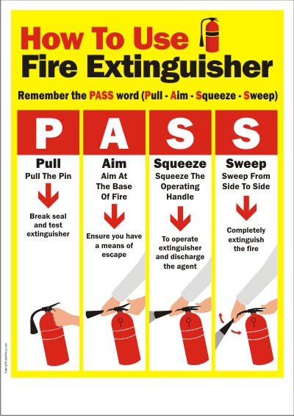
EMERGENCY PROCEDURES — LAB
If there is a hazardous materials spill…
DO NOT attempt to clean up the spill
Contact lab instructor or supervisor for further instruction.
In the case of eye exposure: flush eye for 15 minutes at eyewash station
In the case of skin exposure: remove all clothing and stand in lab shower for 15 minutes.
In the case of inhalation: move to fresh air, and find further information on chemical inhaled.
If there is a small fire…
Remove people from the area
Activate closest fire alarm
Call Campus Safety
Attempt to use a fire extinguisher to douse the flames. Make sure to know the location of fire extinguishers in your lab!
If the fire is not put out after using one fire extinguisher, leave the room and close the door behind you.
If you are trapped in a building…
Call Campus Safety
Close all windows
Wet cloth material and place under or around door to prevent smoke from entering
If someone is at risk, protect yourself first, only provide assistance if you can do so safely.
Alert your supervisor of the situation so that proper actions can be taken.

Slide 6


GET PROPER LAB SAFETY TRAINING!
know the right behaviors!
wear proper attire!

